Slide 1
Comments on Black Hole Interiors
Juan Maldacena
Institute for Advanced Study

Slide 2
Conservative point of view
Expansion parameter =
Information seems to be lost perturbatively.
n point correlators display information loss
This is still consistent with unitarity.
For outside observables, non-perturbative accuracy is needed to be sensitive to the difference between unitary and non-unitary evolution.

Slide 3
AMPS
Almheiri, Marolf, Polchinski, Sully
Do not care how you do the computation.
Display a contradiction in the complementarity style picture of the physics at late times.
Doing the computation might be impossible (Harlow-Hayden)

Slide 4
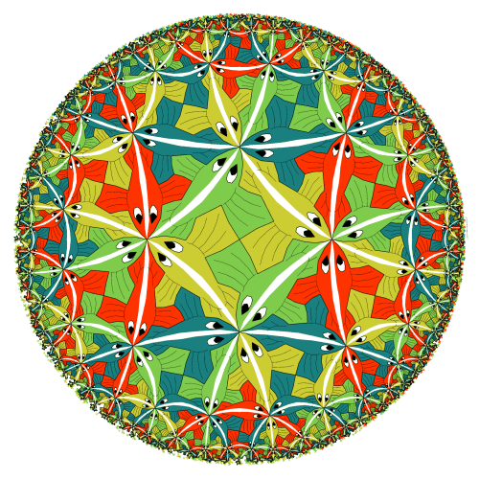
Black holes in AdS
Black holes as seen from the outside
can be described by a unitary quantum
mechanical system.
This is completely understood only when we
go very far away.
Geometry is supposed to emerges from the
unitary boundary description.
Outside: a space-like direction emerges
Interior: a time-like direction emerges ???
Locality in the bulk is not manifest in the boundary
description. ( And it is not present for all boundary
theories! )
Therefore the emergence of the interior might
require us to understand first locality in the bulk and
could depend on special details of strongly coupled
quantum field theories.

Slide 5
An indirect argument against firewalls
The Hawking prediction for the temperature depends on the smoothness of the horizon.
Once the horizon is not smooth, the temperature could change dramatically.
Black holes could explode!.
The thermal picture from the gauge gravity duality suggests that the system continues to have the usual thermal properties, as seen from the outside.

Slide 6
We need to understand the emergence of the interior !

Slide 7
Interior
Interior
Exterior₂
Exterior₁
Exterior

Slide 8
A toy model for black hole interiors
Simple toy model to understand how the interior could emerge from some approximation.
It is NOT a perfect analogy.

Slide 9
The model
Non – relativistic particles in three spatial dimensions, interacting with an external potential V(r) and an inter-particle potential:
Hard wall
r

Slide 10
Asymptotic
observer
.
.
.
.
The atmosphere = zone
Outside observer
Most particles are in the very deep region of the potential.
No particle is allowed to go to r<1.
Particles are fairly dilute in the atmosphere, they do not interact much with each other
in the atmosphere. They interact with the rest of the particles via an effective potential,
which is insensitive to the precise configuration of the charges in the deep region.
We are at finite temperature, or we are in an excited state of the system.

Slide 11
The interior
→ Mirror charges
The surface of the sphere behaves like a conductor.
We then have mirror charges.
The mirror charges are an effective description of the
surface degrees of freedom.
The position of the real charge and the mirror one are
correlated. They are entangled. These are two
independent degrees of freedom which are entangled.
i.e. we can freeze the mirror charge (freezing the charges
on the ``horizon’’) and move the original charge
independently.
(no dynamical electric field)
Horizon charges

Slide 12
We have an analog of an approximate interior and exterior Hilbert spaces.
These are the Hilbert spaces for the charges and mirror charges.
Most of the charges are concentrated at the surface (``horizon’’). For such charges we cannot talk about mirror charges, but such charges do not appear in the interior or exterior Hilbert space. These account for most of the microstates.

Slide 13
The correlation (in the positions of the charge and its mirror) continues to exist even for a thermal or mixed state.
Here we are assuming that most of the free energy and entropy of the system comes from the ``Horizon’’ charges and that they adjust, even at finite temperature to make sure that the mirror charge is present.
We need that the free energy cost for moving the mirror charge away from the original charge is large:

Slide 14
Complementarity (quantum membrane paradigm) → mirror charges are part of the ‘’Horizon’’ degrees of freedom, or part of the full microscopic description.
“UV – issues” when propagate the charge and mirror charge into the past until they are very close to the conductor.

Slide 15
Emission process
Parihk Wilczek 99
.

Slide 16
Particle falling into black hole
Trajectories similar to the ones for a falling
particle in Schwarzschild coordinates.

Slide 17
Defect of the model
We wanted (roughly)
EPR
x_{m}
x
x
Note that the relative coordinate is in a uniform wavefunction →
no information on the time of emission.
The emission times for the pair could depend on the microstate in a strong fashion.
We wanted them to be approximately independent of the microstate.
The quantum state in the environment of a black hole is purer than what we apparently
have for this model.

Slide 18
Information loss
Hawking
In thermal ensemble, charges and mirror charges are correlated (are in a ``pure state’’ with respect to their angular positions if we do the thermal average)
When a charge is emitted → we lose the information about the correlation with the mirror charge. (Correlation in the angular position). If we do not observe the mirror charge!.
It looks like entropy is increasing, since we are averaging over the position of the mirror particle.
Solution: The correlation between the particle and its mirror is just that of a charge and the rest of the system (rest of horizon charges). Most microstates contain this correlation. The entropy does not increase.

Slide 19
Firewalls
Almheiri, Marolf, Polchinski, Sully
All of their four initial assumptions have a parallel here.
Most are obvious.
One requires a translation:
`` Nothing unusual happens for the observer falling in ‘’
→ translates into →
`` charges and mirror charges continue correlated as we expect “
(Defect, these correlations are not as strong as in the black hole case)

Slide 20
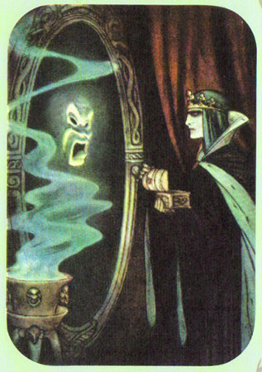
Does the mirror continue to work when it is fully thermalized ?
Or it is in a particular typical microstate? Or is ``old” ?
Reasoning as in AMPS you would conclude that charges and mirror charges cease to be correlated for ``old’’ mirrors !.
Firewall = mirror not working.
Physical intuition and free energy arguments say that they are correlated.
Central issue here: the Horizon degrees of freedom and the zone ones, are living in a bigger Hilbert space, with log (dim) > S .
However, due to the defect in the model that I mentioned, we
cannot argue that the state of charges and mirror charges is as pure as that for Hawking modes. So the ``no drama’’ postulate does not hold with equal strength in this model as for a black hole.
Conclusion: It seems that we are chipping away a bit from the wall.

Slide 21
We do not expect firewalls for modes that are not carrying information outside.
For the modes carrying information, we cannot exclude it… yet…
Discussions with Susskind…

Slide 22
Creation operator for a mirror charge decreases the charge.
But it does not appear to be a problem for its approximate existence.

Slide 24
Another toy model
J.M, Moore, Seiberg, Shih
Simple matrix integral:
Is an analytic function of M .
ϕ has a branch cut at x = 1, but the exact answer does not.
Interior = second branch.
x
Exponentially decaying
oscillating

Slide 25
The correct model
Theory with a gravity dual, e.g. N=4 SYM
At finite temperature
Find the right approximation….

Slide 26
Conclusions
This is a simple toy model that captures many conceptual features of black holes.
But not all of them!
Many of the arguments that are usually made, which do not use many of the specific features of black holes, have a translation to this simple model.

